Slide 1
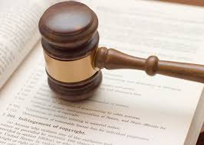
Intellectual Property

Slide 2

What is Intellectual Property??
Intellectual property refers to creations of the ideas, inventions; literary and artistic works, symbols, names and images used in commerce.

Slide 3
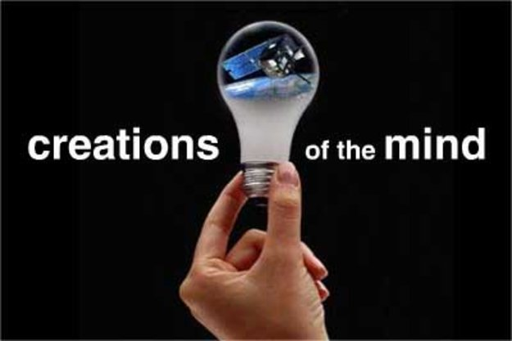
What is Intellectual Property??
Intellectual Property Rights are like any other Property Right.
They allow creators, or owners, to benefit from their own work or investment in a creation.

Slide 4


IP is Divided Into Two Categories??
Industrial Property: Includes patents for inventions, trademarks, industrial designs.
CopyRight: Covers literary works
(such as novels, poems and plays), films, music, artistic works, even programming (e.g., drawings, paintings, photographs and sculptures) etc.

Slide 5




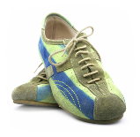
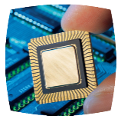
Five Main Types Of IP Rights??
Patents
Trade Mark Copy Right
Industrial Design
Integrated Circuit Topography

Slide 6
What is a Patent??
“Invention in Documented form”
A patent is an exclusive right granted for an invention – a product or process that provides a new way of doing something, or that offers a new technical solution to a problem.

Slide 7
What is a Patent??
New inventions or any new and useful improvement of an existing invention
Novel: must be new, first in the world
Useful: functional and operative
Inventive: must show ingenuity and innovative

Slide 8
Protection Do Patents Offer?
Patent protection means an invention cannot be commercially made, used, distributed or sold without the patent owner’s consent. Patent rights are usually enforced in courts that, in most systems, hold the authority to stop patent infringement. Conversely, a court can also declare a patent invalid upon a successful challenge by a third party.

Slide 9
Rights Do Patent Owners Have?
A patent owner has the right to decide who may or may not use the patented invention for the period during which it is protected. Patent owners may give permission to, or license, other parties to use their inventions on mutually agreed terms.

Slide 10

Copy Right??
Rights derived from any
original literary, dramatic,
musical or artistic work
can be registered
from the moment this
work is created.

Slide 11

Copy Right??
Copyright is automatic upon creation. However, it’s a good idea to:
Have your original work witnessed and dated
Register your copyright
Use proper marking for your copyright ©
Document details of any
collaboration in respect of the work.

Slide 12
What Rights do Copyright and Related Rights Provide?
The creators of works protected by copyright, and their heirs and successors (generally referred to as “right holders”), have certain basic rights under copyright law. They hold the exclusive right to use or authorize others to use the work on agreed terms.

Slide 13

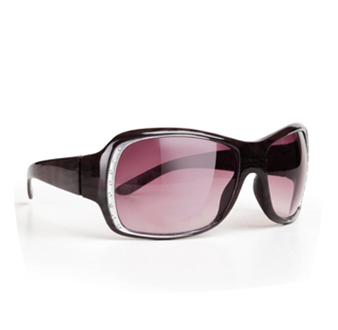
Industrial Design??
Designs are such as those featured in these products, are known for their visual appeal.
Design must be original
Can be two or three dimensional

Slide 14
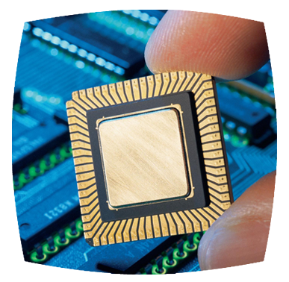
IC’s Topography??
Configuration of electronic circuits embodied in integrated-circuit products or layout designs.

Slide 15

IC’s Topography??
Used in many technologies, such as:
Computers
Automobiles
Pacemakers
Industrial Robots
Cameras
Spacecraft
Etc

Slide 16

Confidential piece of intellectual property that gives company a competitive advantage
Employees are asked to make confidentiality agreement
Examples: Formulas, customers’ lists, strategic plans, proprietary design
Reverse engineering allowed (buying a can of Coca-Cola and trying to figure out it’s formula is legal)
May be compromised when employees leave firm

Slide 17
Safe Software Development
Reverse engineering okay
Companies must protect against unconscious copying
Making the same duplicate of a program because programmers move from firm to another
Solution: “clean room” software development strategy

Slide 18

Open Source Definition
Licenses have the following characteristics:
No restrictions preventing
others from selling or giving
away software
Source code included in
distribution, No restrictions
preventing others from
modifying source code
No restrictions regarding how
people can use software. They
can exchange or sell.
Same rights apply to everyone receiving
redistributions of the software (copyleft)
NOTE: Nothing states that Open Source SW must be given FREE.

Slide 19
Beneficial Consequences of Open-Source Software
Gives everyone opportunity to improve program
New versions of programs appear more frequently
Eliminates tension between obeying law and helping others
Programs belong to entire community
Shifts focus from manufacturing to service
Buying Open Source SW with easy installation steps
Providing great manuals
Providing support after sales

